Slide 1

AI-Powered Real-Time Theft Detection System for Shopping Malls
Group Members:
Muhammad Nadeem(22P-9366)
Laiba Shahi(22P-9247)
Sultan Mehmood Mughal(22P-9242)
Project Supervisor
Dr. Hafeez Anwar

Slide 2
Introduction
An AI-powered theft detection system analyzes CCTV footage to identify suspicious activities in real time, ensuring quick alerts and enhanced mall security through intelligent automation.
Why AI for Theft Detection?
Efficient Video Processing – Handles multiple CCTV feeds simultaneously.
Real-Time Action Recognition – Detects theft-related behaviors instantly.
Faster, Accurate Alerts – Reduces human error and improves response time.

Slide 3
Problem Statement
Current shoplifting detection systems often fail in Shopping malls due to small datasets, occlusion, and crowded scenes. They also struggle to detect multiple thefts under one camera, leading to missed or inaccurate alerts. Therefore, a reliable deep learning-based system is needed to detect multiple thefts accurately in real time, even in complex mall environments.

Slide 4
Primary Objective
To design an intelligent deep learning-based system that can accurately detect and recognize multiple shoplifting incidents in real time within shopping malls.
Specific Objectives
To create an intelligent model that identifies hiding products in pockets(for shalwar and kameez) activities in mall surveillance videos.
To ensure reliable detection even in crowded areas with occlusion and clutter.
To improve accuracy and performance using a large, diverse shopping mall dataset.
To generate instant alerts for multiple thefts occurring under a single camera in real time.

Slide 5
Literature Review
No | Reference | Year | Title | Objectives | Methodology | Results | Limitations | Solution
1 | Sajid et al . | 2025 | A new approach of anomaly detection in shopping center surveillance videos for theft prevention based on RLCNN model | To detect theft-related behavior in shopping centers using hybrid deep learning approach with high accuracy | Hybrid RLCNN (RNN+CNN) trained on UCF50, UCF101, UCF-YouTube,. | 96-97% accuracy; highest performance among compared methods; effective on multiple benchmark datasets | Synthetic/benchmark data only, no cultural or attire adaptation, weak multi-person handling, lacks real-world retail diversity | Collect videos from Pakistani stores with people wearing shalwar kameez and local shopping behaviors
2 | Singh et al. | 2025 | Exploring Pose-Based Anomaly Detection for Retail Security: A Real-World Shoplifting Dataset and Benchmark | To introduce pose-based anomaly detection with new PoseLift benchmark dataset for privacy-preserving shoplifting detection | YOLOv5 for real-time person/object detection + activity recognition module for theft behavior classification | 80% accuracy on PoseLift dataset; pose-based approach maintains privacy while detecting anomalies | mall dataset with limited scenarios, occlusion issues, single-camera only, limited cultural/demographic diversity in poses and attire | Collect videos with people wearing different clothing (traditional dress, loose clothing), various body types, and different cultural shopping styles

Slide 6
Literature Review
No | Author | Year | Title | Objectives | Methodology | Results | Limitations | Solution
3 | Authors TBDl. | 2024 | Machine Learning Based Theft Detection Using YOLO Object Detection | To implement real-time theft detection system using YOLO for practical retail surveillance deployment | YOLO v5 for real-time person/object detection + activity recognition module for theft behavior classification | High qualitative detection in real-time; fast inference suitable for edge deployment | No standardized benchmark dataset, occlusion/clutter handling needs improvement, no multi-theft detection, single-camera only, lacks diverse retail scenarios | Create labeled video dataset from local stores, include multiple people shopping at once.
4 | Ullah et al. | 2020 | Suspicious Behavior Detection on Shoplifting Cases Using 3D CNN | To detect suspicious shoplifting behavior using 3D convolutional neural networks for spatiotemporal analysis | 3D-CNN for simultaneous spatial and temporal feature extraction from video sequences; captures motion patterns over time | ~75% accuracy; demonstrated detection of subtle suspicious movements in surveillance videos | Small training dataset, difficulty with subtle actions, occlusion problems, cannot handle multiple persons, high computational cost, no diversity in retail settings | Create larger video dataset with different lighting conditions, camera angles, and various people performing shopping activities

Slide 7
Literature Review
No | Author | Year | Title | Objectives | Methodology | Results | Limitations | Solution
5 | Chakraborty et al. | 2023 | Shoplifting Detection Using Hybrid Neural Network CNN-BiLSTM and Development of Benchmark Dataset (2023) | To develop a benchmark dataset and hybrid neural network for detecting shoplifting activities in retail environments | CNN for spatial feature extraction + BiLSTM for temporal sequence modeling; trained on 900-video custom dataset with 5 theft categories (pretending, hiding, removing, repositioning, swapping) | 81% accuracy on benchmark dataset; successfully classified different shoplifting patterns across multiple categories | Small dataset (900 videos), occlusion in cluttered environments, cannot track multiple simultaneous thefts, limited to single-camera view, lacks regional/cultural diversity | Collect more videos from diverse stores, use data augmentation, add multi-camera setup, include different cultural shopping behaviors
6 | Authors TBD | 2025 | Shopformer: Transformer-Based Framework for Detecting Shoplifting via Human Pose | To leverage transformer architecture for capturing long-range temporal dependencies in pose sequences for shoplifting detection | Transformer with self-attention on human pose sequences; processes skeletal keypoints to identify anomalous movement patterns | Outperformed CNN-LSTM and 3D-CNN baselines; effectively captured long-range temporal dependencie | Pose-only (no object/context), scene clutter impacts performance, single-camera limitation, no multi-theft detection, limited dataset diversity | Add object detection (items being picked/hidden), include videos from multiple camera angles, test with different cultural body movements

Slide 8
Methodology
Dataset Collection
5 Subjects
Different Angles (per scene)
Distances variations
Lighting
Poses / actions
Clothing variations
Occlusions & clutter
Total images: 5,000 – 6,000 images

Slide 9
Methodology Continued…
Pre-Processing and Dataset Annotation
Object Detection
Action Recognition
Alert Generation & Notification
Evidence Storage & Feedback

Slide 10
Important Diagrams

Slide 11
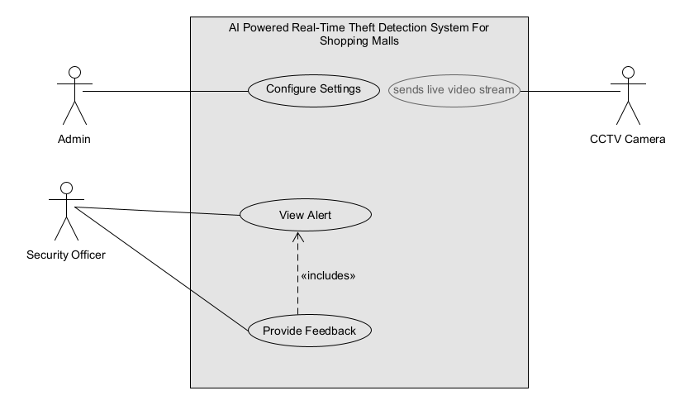
Use Case Diagram

Slide 12
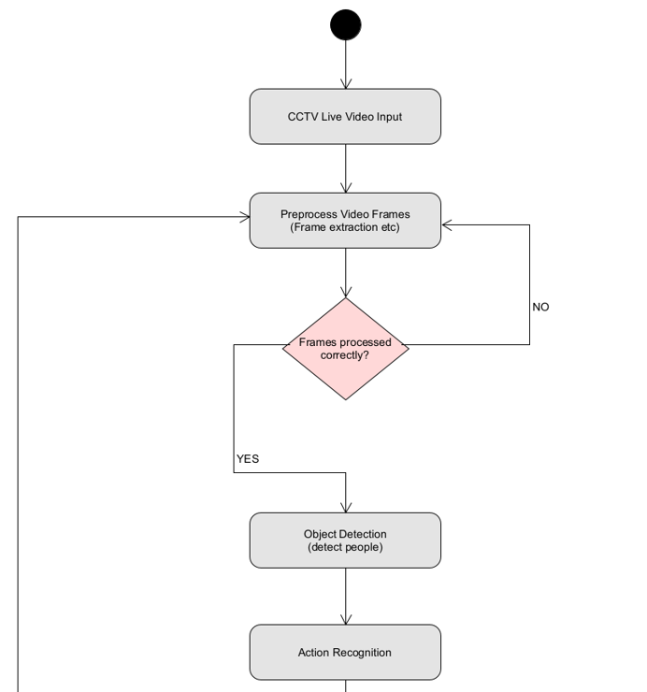
Flowchart (Activity Flow)

Slide 13
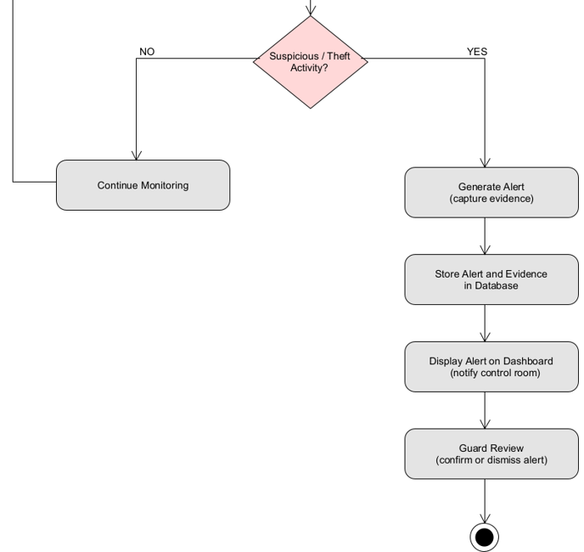
Flowchart (Activity Flow)

Slide 14
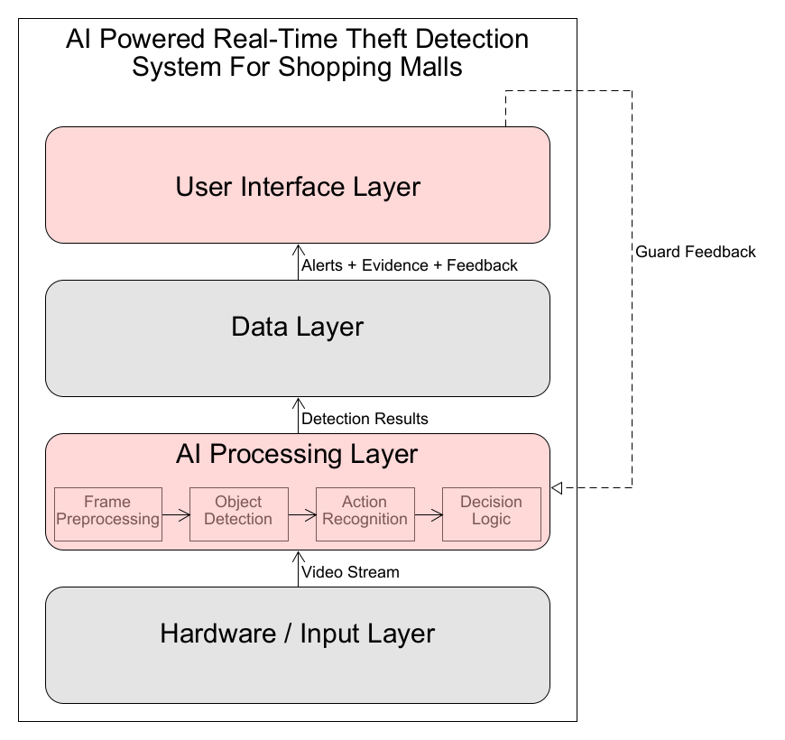
System Architecture Diagram

Slide 15
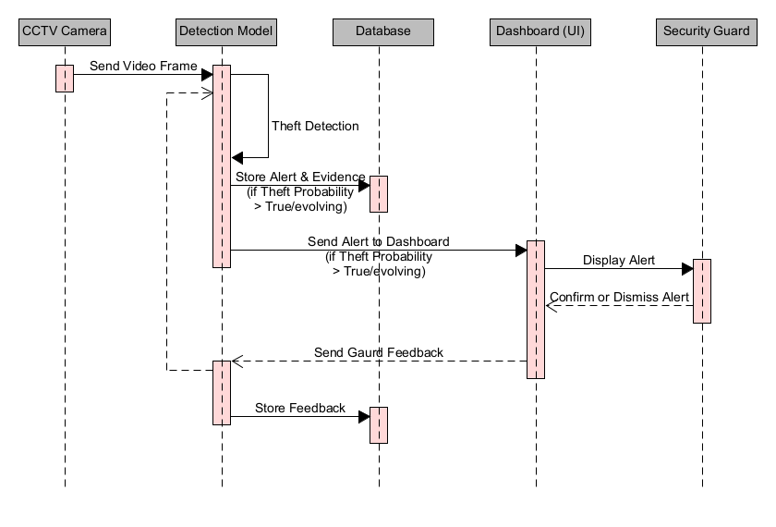
Sequence Diagram

Slide 16
Work Done
Literature Review
Data Set (in progress)
UML Diagrams

Slide 17
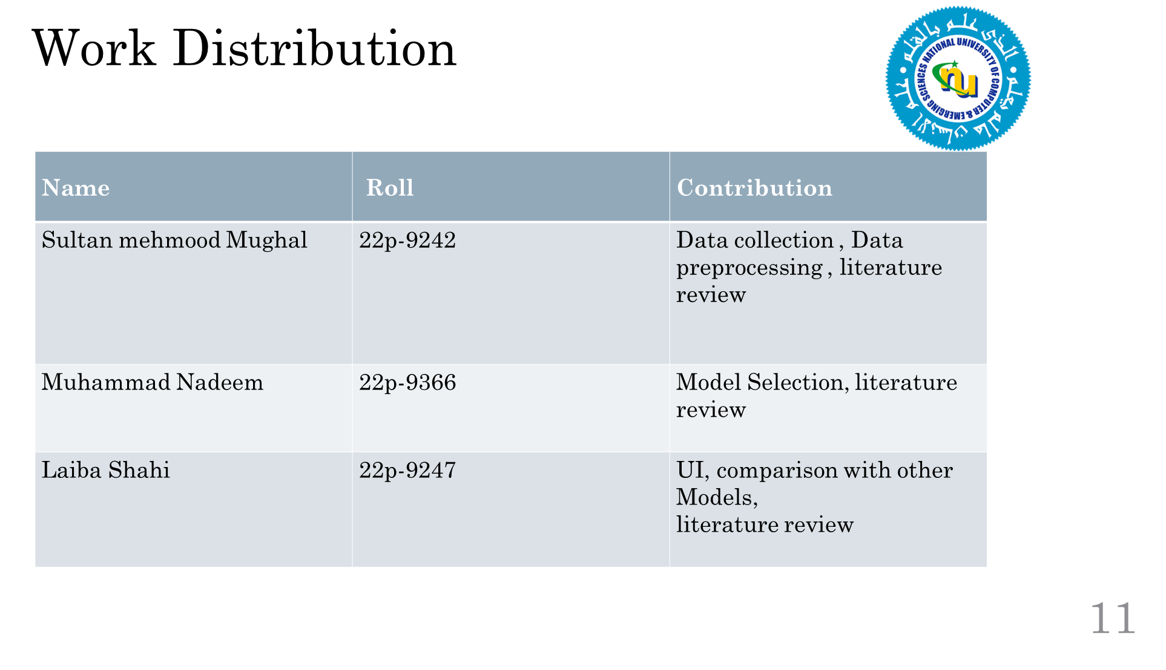

Slide 18
References
[1] Sajid, M., Khan, A.H., Malik, K.R., Khan, J.A. and Alwadain, A., 2025. A new approach of anomaly detection in shopping center surveillance videos for theft prevention based on RLCNN model. PeerJ Computer Science, 11, p.e2944.
[2] Rashvand, N., Noghre, G.A., Pazho, A.D., Yao, S. and Tabkhi, H., 2025. Exploring Pose-Based Anomaly Detection for Retail Security: A Real-World Shoplifting Dataset and Benchmark. In Proceedings of the Winter Conference on Applications of Computer Vision (pp. 1123-1131).
[3] Khadse, S., Nandanwar, B., Kirme, A., Bagde, T. and Kamble, V., 2022. Machine Learning Based Theft Detection Using Yolo Object Detection. Doi https://doi. org/10.32628/IJSRST.
[4] Martínez-Mascorro, G.A., Abreu-Pederzini, J.R., Ortiz-Bayliss, J.C. and Terashima-Marín, H., 2020. Suspicious behavior detection on shoplifting cases for crime prevention by using 3D convolutional neural networks. arXiv preprint arXiv:2005.02142.
[5]Muneer, I., Saddique, M., Habib, Z. and Mohamed, H.G., 2023. Shoplifting detection using hybrid neural network cnn-bilsmt and development of benchmark dataset. Applied Sciences, 13(14), p.8341..
[6] Rashvand, N., Noghre, G.A., Pazho, A.D., Ardabili, B.R. and Tabkhi, H., 2025. Shopformer: Transformer-Based Framework for Detecting Shoplifting via Human Pose. In Proceedings of the Computer Vision and Pattern Recognition Conference (pp. 5752-5761).

Slide 19
Thank You

